Slide 1
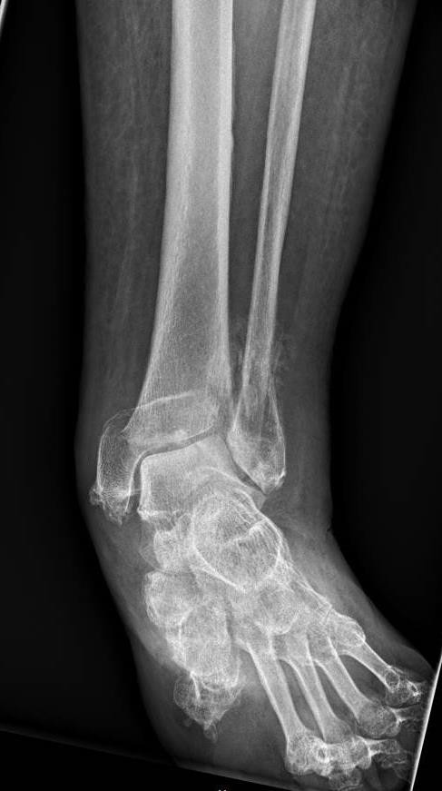
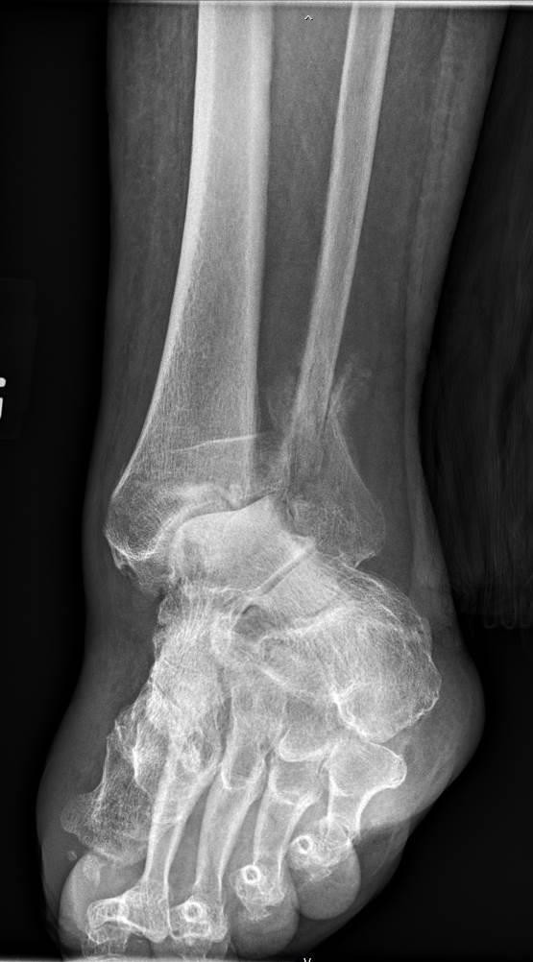
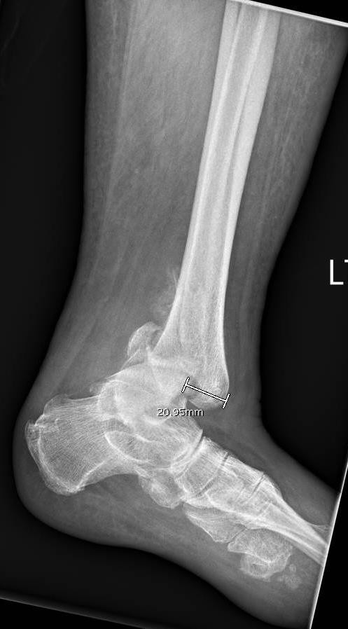
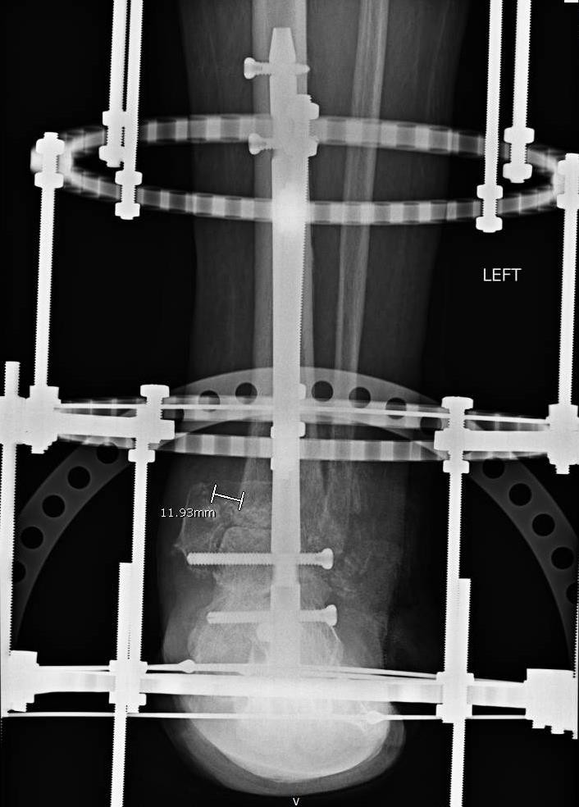
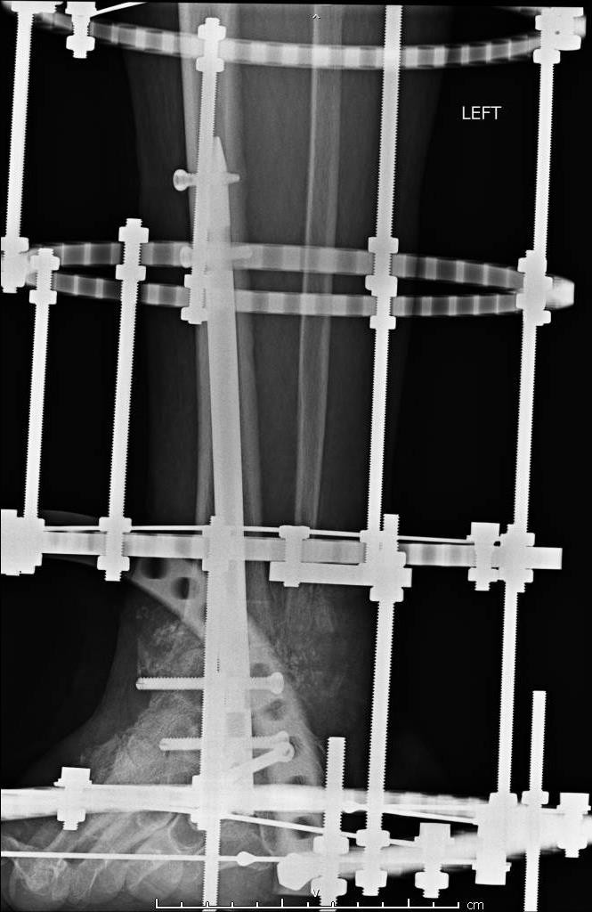
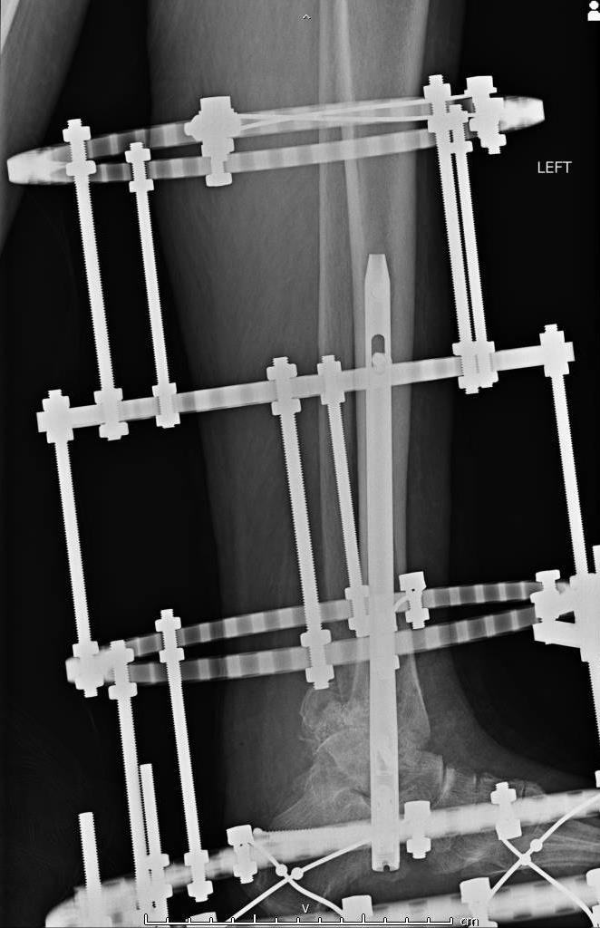
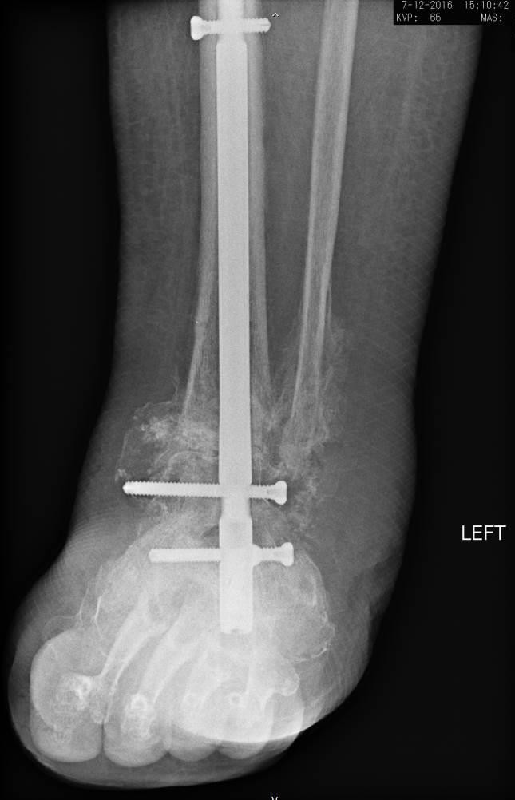
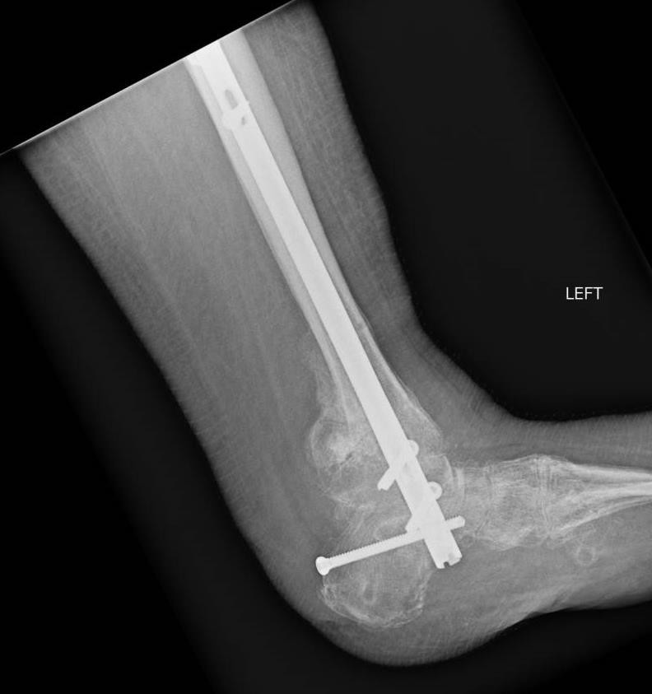
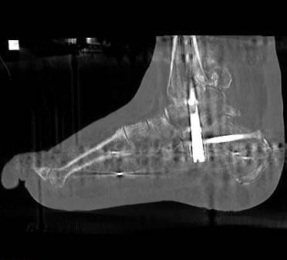
Open Reduction and Internal Fixation of a Neglected Posterior Pilon Variant Fracture in an Uncontrolled Diabetic with Peripheral Neuropathy: A Case Report and Literature Review
Nathaniel Preston DPM ª, Chandana Halaharvi DPM ª, Randall Thomas, DPM, AACFAS ^{b,c}
ª Resident, Grant Medical Center Foot and Ankle Surgery Residency Program, Columbus OH
^{b} Assistant Director, Grant Medical Center Foot and Ankle Surgery Residency Program, Columbus OH
^{C} Private Practice, Clintonville/Dublin Foot & Ankle Group, Columbus OH
Introduction
It is estimated that 4 % of all fractures are ankle fractures, and pilon fractures as a whole represent less than 1% of all lower extremity fractures (7). Amongst those, 7% to 44% of all ankle fractures involve the posterior malleolus (6). In a retrospective case series of 270 patients suffering from unstable ankle fractures, the relative frequency of the posterior malleolar fracture was noted to be 50%, and of those fractures 20% represented the posterior pilon variant (10). The posterior pilon variant fracture pattern is an increasingly recognized fracture morphology characterized by posteromedial extension of the fracture of the posterior rim of the tibia including a portion of the medial malleolus with varying amounts of articular impaction of the tibial plafond. (10) This fracture pattern has a severe impact of the stability of the talus in the ankle mortise, and often results in tibiotalar subluxation and dislocation. (12)
Case Report
A 66 year old female with past medical history uncontrolled IDDM, HTN, TIA, Peripheral Neuropathy, Depression, and disc herniation who presented to the ER with complaint of acute pain and disfigurement to her left ankle. She related an event 6 weeks prior to presenting to the ER in which she fell at home and heard something distinctly “pop in her left ankle”. She had significant swelling to her ankle since the described inciting event but did not pursue treatment and continued to ambulate normally with full weight bearing to the affected extremity. She then had another subsequent fall at home and noticed a frank change in the position of her ankle with sudden increase in pain.
No open wounds were appreciated to the affected extremity and the patient denied constitutional symptoms. The patient was found to be hyperglycemic blood sugar of 565 (Ha1c 12.3), leukopenic, thrombocytopenic. The patient’s pancytopenia lead to the diagnosis of multiple myeloma however she refused to pursue treatment or further evaluation.
Edema at ankle, both the PT and DP pulses were audible on Doppler exam. Capillary fill time to the remaining digits of the left foot was immediate. The foot did appear clinically subluxed with a valgus position at the level of the ankle joint. Light touch sensation was absent distal to the level of the mid-tibia bilaterally. Her compartments were soft and compressible and her pain was not felt to be out of proportion.
On plain film radiographs she was found to have an AO43-C2 fracture pattern with an oblique weber B fibular
fracture oriented from distal anterior to proximal posterior, a spiral fracture of the posterior malleolus with
extension into the medial malleolus and 1.1cm medial displacement, approximately 15 degrees of traumatic
valgus rotation focused at the level of the ankle joint, and 2.1cm of posterior tibiotalar subluxation. Periostitis
around the fracture margins of the injury had a minimum radiographic age of 4 weeks. (figure 1). CT without
contrast was obtained. The Fracture was re-demonstrated with the additional findings of comminution of
posterior mal and medial mal components with approximately 1cm of posterior displacement and 1.5cm of
proximal displacement of the posterior mal component. Approximately 45% of the distal tibial articular surface
was involved in the fracture. Given her uncontrolled DM, peripheral neuropathy and the age of the injury a below
knee amputation was recommended to the patient as a potential principle procedure however the patient
refused and was insistent upon pursuing limb salvage efforts.
Operative Technique
The patient was positioned in a secure supine position. Approximately 20mL of bone marrow aspirate was harvested from the calcaneus using a Jamshidi needle. A percutaneous TAL was performed. Fluoroscopy was used to plan anteromedial and lateral ankle incisions. The anteromedial incision was focused over the medial ankle gutter while the lateral incision was made overlying the distal 1/3rd of the fibula for the purpose of distal fibular takedown. Ankle joint was non salvageable. The distal fibular fracture was readily identified with frontal plane rotation in eversion and lateral displacement. There was significant comminution and impaction of the distal tibia with posterior and proximal migration of the foot as a whole at the level of the ankle. Distal fibula was used for graft.
The ankle joint was prepared through minimal incisions. An incision was then made to the lateral hindfoot for the purpose of preparation and reduction of the subtalar joint A manual reduction was then performed relocating the talus under the tibial plafond and pulses remained palpable to the extremity with capillary refill time immediate to the residual digits. Temporary pin fixation was used to maintain reduction of the medial malleolar fracture f fragment and the tibia was then reamed and a 240x10mm intramedullary rod was advanced through the calcaneus and talus into the distal tibia spanning both subtalar and ankle joints. The nail was secured in static fashion using intra-operative fluoroscopy. A 200mm multi-ring static external fixator was then affixed for weight bearing compliance and additional compression. (Figure 2)
Discussion
Fractures of the medial and lateral malleoli are often times accompanied by fracture of the posterior malleolus thus constituting a trimalleolar ankle fracture. The posterior pilon variant fracture pattern is an increasingly recognized fracture morphology characterized by posteromedial extension of the fracture of the posterior rim of the tibia including a portion of the medial malleolus with varying amounts of articular impaction of the tibial plafond. (10) This fracture pattern has a severe impact of the stability of the talus in the ankle mortise, and often results in tibiotalar subluxation and dislocation. (12) Proposed mechanisms of injury resulting in this distinct fracture pattern include forced hyperplantarflexion, an abduction-external rotation force, and a combination of rotational and axial loads.
(10) Studies have also suggested a poorer prognosis and higher articular incongruity with ankle fractures involving a posterior malleolus component, including the posterior pilon variant. (11,13)
In this case the patient’s severe peripheral neuropathy and psychosocial issues prevented her from seeking immediate medical treatment and evaluation of her ankle injury. This resulted in a delayed presentation of 6 weeks duration. At the time of diagnosis of her posterior pilon variant, significant bony callus formation was appreciated adjacent to her fracture margins further limiting the ability to appropriately close reduce her fracture/dislocation. Decision was made to pursue a joint destructive procedure and remain as minimally invasive as possible with the preparation of her ankle and subtalar joints for the purpose of arthrodesis. The nature of her injury and the timeframe of surgical intervention increased the difficulty of operative reduction however we were able to successfully translocate the talus and foot as a unit anteriorly under the distal residual tibial plafond. The stability afforded by her static intrameddulary nail has allowed her to resume full unrestricted weight bearing at 12 weeks post-op and she has returned to pre- injury levels of daily activity.
To the authors knowledge no other case reports of neglected posterior pilon variant fractures have been presented in the literature. This case was certainly heroic limb salvage, however represents a potential addition to the treatment algorithm of neglected trimalleolar and posterior pilon variant fractures in the compromised patient insistent upon pursuing salvage of their affected extremity.
Figure 1 – Initial Films Obtained at Presentation to ER
Literature Review
The original pilon fracture was initially described by Destot in 1911 (7). The mechanism of injury in such fractures are either through axial/compressive loading or through a rotational force or both (1,7). The posterior pilon variant has only been recently discussed in the literature although it is an increasingly recognized fracture morphology. The earliest description of the fracture variant is by Karachalios in 2001 where he noticed a distinct fracture pattern of the posterior malleolus where it split into a posteromedial and posterolateral fragment (6).
Due to the increased complexity of the fracture pattern, it is recommended to follow a systematic approach. Klammer et. al proposed a classification which describes 3 major categories of increasing degree of complexity and the operative strategy for each. Type 1 fractures contain a single medially based posterior malleolar fragment which can be fixated through a posterior lateral approach. Type 2 fractures are those in which the posterior fragment is split with possible posteromedial comminution, which would require an additional incision medial or limited posteromedial to reduce and fixate the posteromedial fragment or separate medial malleolar fracture. For type 3 fractures, there is an additional anteromedial fragment present which necessitates a medial approach in addition to a posterolateral incision for appropriate reduction and fixation. They recommend the fibular fracture to be addressed only after the tibia has been fixated and that syndesmosis may need addressed.
To the authors knowledge there is currently no other documented case of a posterior pilon variant fracture being treated with a combination of intra-medullary nailing and multi-ring external fixator. The purpose of this case report was to examine the functional outcome of a neglected posterior pilon variant fracture addressed using this fixation in a high risk patient with neuropathy.
References
Amorosa, F. Louis. “A Surgical Approach to Posterior Pilon Fractures.” Journal of Orthopedic Trauma. Vol 24, no. 3, March 2010: 188-193.
Gonzalez, Olga. et. al. "Radiographic Assessment of Posterior Malleolar Ankle Fractures." Journal of Foot & Ankle Surgery. vol 54, 2015: 365-69.
Haraguchi, Naoki, et. al. “Pathoanatomy of Posterior Malleolar Fractures of the Ankle.” The Journal of Bone and Joint. Vol 88, no.5, May 2006: 1085-1092.
Hooff, Cornelis C.D.V. et. al. “Influence of Fragment Size and Postoperative Joint Congruency on Long-Term Outcome of Posterior Malleolar Fractures.” Foot and Ankle International. Vol 36, no.6, 2015: 673-678.
Ketz, John; Sanders, Roy. “Staged Posterior Tibial Plating for the Treatment of Orthopedic Trauma Association 43C2 and 43C3 Tibial Pilon Fractures.” Journal of Orthopedic Trauma. Vol 26, no. 6, June 2016: 341-346.
Klammer, Georg. Et. Al. “Posterior Pilon Fractures: A retrospective case series and Proposed Classification System. Foot and Ankle International. Vol 32, no. 2, 2013: 189-199.
Southerland, JT. Et al. McGlamry’s Comprehensive Textbook of foot and ankle surgery. Fourth Edition. Wolters Kluwer Health / Lipponcott Williams & Wilkins. 2013
Odak, Saurabh et. al. “Management of Posterior Malleolar Fractures: A Systematic Review. The Journal of Foot and Ankle Surgery. Vol 55, 2016: 140-145.
Ruokun, Huang. Et. Al. “Postoperative Radiographic and Clinical Assessment of the Treatment of Posterior Tibial Plafond Fractures Using a Posterior Lateral Incisional Approach. The Journal of Foot and Ankle Surgery. Vol 53, 2014: 678 – 682.
Switaj, J Paul. et. al. “Evaluation of Posterior Malleolar Fractures and the Posterior Pilon Variant in Operatively Treated Ankle Fractures. Vol 35, no. 9: 2014: 886-895.
Veltman, Ewout, et. al. “Long-term Outcome of 886 Posterior Malleolar Fractures: A Systematic Review.” Foot and Ankle Surgery. Vol 22, 2016: 73- 77.
Weber M. Trimalleolar fractures with impaction of the posteromedial tibial plafond: implications for talar stability. Foot Ankle Int. 2004;25:716-727.
Broos PL, Bisschop AP. Operative treatment of ankle fractures in adults: correlation between types of fracture and final results. Injury. 1991;22:403-406.
Figure 2 – Immediate post-op images
Post-op Course
After a brief admission the patient was discharged to a skilled nursing with instructions to remain strictly non-weight bearing to the left lower extremity. She followed outpatient in the office of the primary author weekly for serial evaluation (RT). CT imaging was obtained 9 weeks post-operatively showing maintenance of reduction / fixation with 20% fusion of the ankle joint, however, no fusion was appreciated spanning the subtalar joint. Her pin sites were treated with daily applications of hibiclens solution and she did not any signs of infection. Her incision sites healed without incident.
Repeat CT showed increased fusion and the patient returned to the OR post-op week 10 for removal of her external fixator and manipulation under anesthesia. The frame was removed without incident and all pin sites were treated with curettage and irrigation. Both ankle and subtalar joints were stressed under intra-operative fluoroscopy and found to be stable with no appreciable motion.
She remained strictly non-weight bearing for 12 weeks. She then advanced to partial weight bearing with PT in a cam boot. She further progressed to full unrestricted weight bearing at post-op week 17. She has had resolution of pain and has returned to pre-injury level of activity. Now greater than one year post op .(Figure 3)
Figure 3

